Slide 1
The Performance Challenge Providing an amazing customer experience no matter what.
Sept 27, 2016
Nick Panahi – Sr. Product Manager, Search
Notes:
Hello, thank you for joining us and welcome to another episode in our series of webinars for architects.

Slide 2
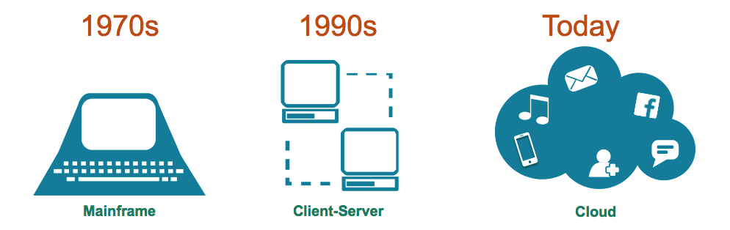
The Data Platform Evolution
© DataStax, All Rights Reserved.
Notes:
Before we get into our discussion on performance, let ‘s first look at the evolution of computing platforms. Computing started with mainframes. With the advent of the internet and the ability for servers to connect with each other, was born the client-server architecture. Today, we have hosted web-applications and mobile apps, built for the “cloud”.

Slide 3


Top 5 Challenges of Cloud Applications
Notes:
These Cloud Applications are expected to behave and perform differently than traditional applications. Consider a company was was building an application 10 years ago from the company headquarters in California, it would think about the region and local users.

Slide 4
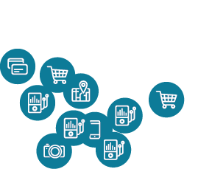
Top 5 Challenges of Cloud Applications
Notes:
But today, companies cannot afford to think that way. Feeds, integrations and users for today’s applications are going to be very distributed from the outset

Slide 5
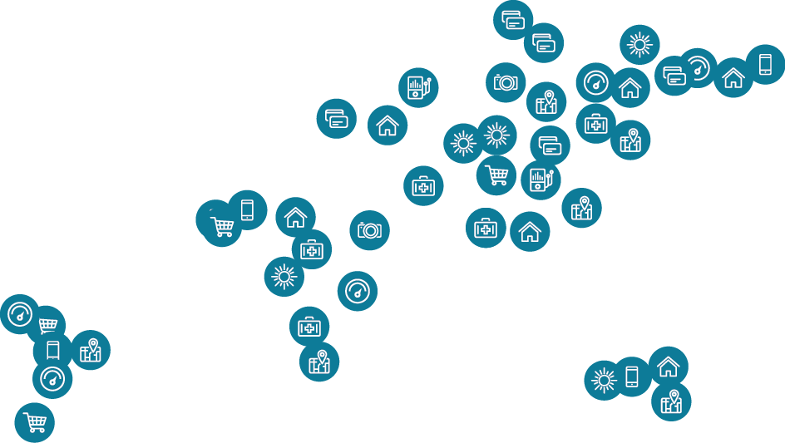

Top 5 Challenges of Cloud Applications
Notes:
So the end points for the app are going to be numerous and highly distributed.
Consider Netflix.

Slide 6
Top 5 Challenges of Cloud Applications
Scalability
Availability
Security
Performance
Agility / Manageability
Notes:
Creating applications that span so many endpoints and can handle simultaneous users is made possible today because of the cloud; in-house private data centers or public offerings and very often - both. Leading to extremely complicated setups very quickly. Cloud applications present 5 big challenges from it’s needs.
Scalability
Performance
Availability
Security
Agility and Manageability

Slide 7
Top 5 Challenges of Cloud Applications
Scalability
Availability
Security
Performance
Agility / Manageability
Notes:
Today, we’re going to focus on The Performance Challenge.

Slide 8
The Performance Challenge
Notes:
Let’s put performance into perspective with regards to cloud applications.

Slide 9
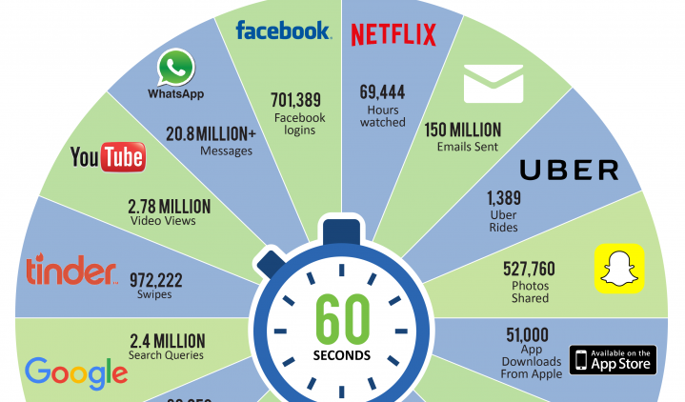
Notes:
This graphic illustrates “what happens in an internet minute.” Lots of activity in an internet minute. First and foremost, cloud applications need to be able to process and store the sheer amount of data/work involved with cloud applications. Second, interacting with data often needs to happen within a window commonly referred to as “real-time”.

Slide 10

Time is $
© DataStax, All Rights Reserved.
Notes:
Latency can cost money. Being slow can be just as bad as being down.

Slide 11

Amazon found every 100ms of latency cost them 1% in sales.
© DataStax, All Rights Reserved.
© DataStax, All Rights Reserved.
Notes:
If site is slow to process my order, I go to another site for the same product.

Slide 12

Google found an extra .5 seconds in search page generation time dropped traffic by 20%.
© DataStax, All Rights Reserved.
Notes:
A broker could lose millions if their electronic trading platform is 5 milliseconds behind the competition.

Slide 13
Powering Cloud Applications

Slide 14
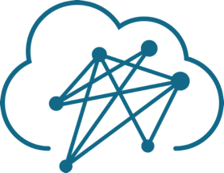
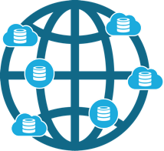
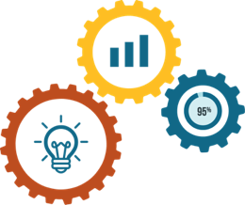

Powering Cloud Applications
+
+
Distributed
Responsive
Intelligent
Notes:
We realized that for cloud applications to really be effective in general, our customers needed them to be able to incorporate three conditions.
The cloud apps need a technology platform that is capable of being Distributed, Responsive, and Intelligent.
Distributed – meaning work across regions, data centers and hybrid environments – with users & machine-to-machine
Responsive - Interactive and immediate
Intelligent – provide real-time information so that the apps can use the information and adapt their user interactions.
All three factors need to be catered to, in order to deliver cloud applications that are the intersection of real-time value at epic scale.
With regards to each condition, let’s look at them with performance in mind.

Slide 15
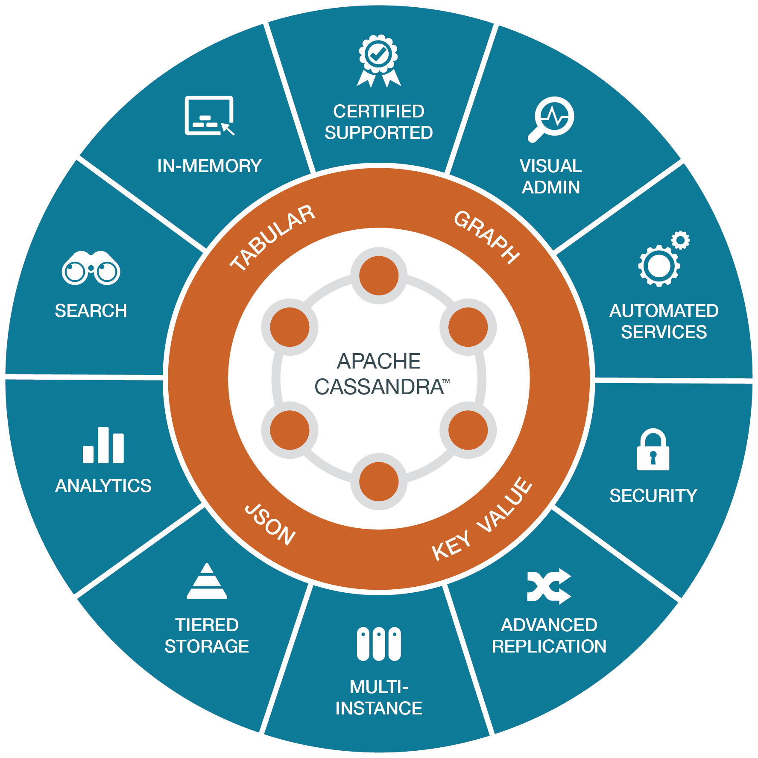
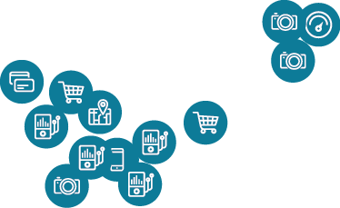
Notes:
Distributed, Responsiveness
In order to have a highly available application, it must be deployed onto a “Active Everywhere” infrastructure, that means providing fully active reads/writes and the ability for it to be distributed where you need it.
To provide consistent performance for users in different regions, data should be local to the user which means data needs to be distributed. Distributed data that becomes local provides low latency with response times fast enough for your most intense operational cloud applications.

Slide 16



The Modular Cloud Application
Your Application
Time Series | Customer Profile | Shopping Cart
Personalization | Recommendation | Fraud Detection
Your Database Infrastructure
Workloads
Transactional Analytical Search
Data Models
Key Value Tabular Document Relational Graph
© DataStax, All Rights Reserved.
Notes:
With regard to intelligence, consider common cloud application functionality. In order to provide all of this functionality seamlessly with 1 application, it requires looking at data differently and potentially storing data in different structures to facilitate different workloads. With traditional technologies this can be done through a process like ETL. Extracting, Transforming and Loading data takes time.

Slide 17
Accelerating performance with DSE

Slide 18
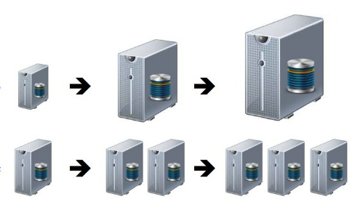
Two Approaches
Scale Up: Most RDBMS’s and Some NoSQL
Scale Out: Some NoSQL, but…
Ask the question: Can you scale out BOTH writes and reads?
© DataStax, All Rights Reserved.
Notes:
There are 2 ways to gain performance.
With regards to scaling out, distributed systems provide their own set of challenges (CAP).

Slide 19
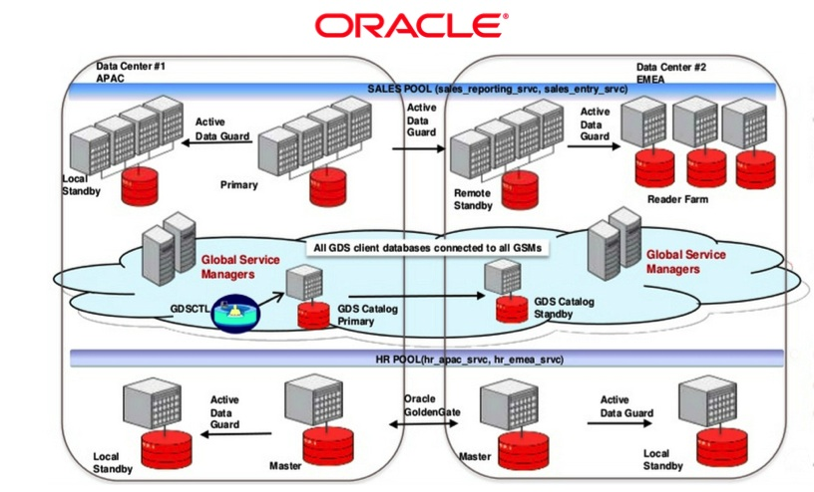
Why Legacy Databases Won’t Work
© DataStax, All Rights Reserved.
Notes:
Performance in business requires a technical architecture that is able to provide consistent performance regardless of data size or workload.
Legacy Databases have put more focus on structure, relationships and transactions, concepts while important for the applications they were geared for, they are not capable of the performance requirements of today’s cloud application. As previously discussed, ETL processes introduce more latency as data is moved system to system.
Here’s an example showing the complexity, manual integration, and lots of points of failures.

Slide 20
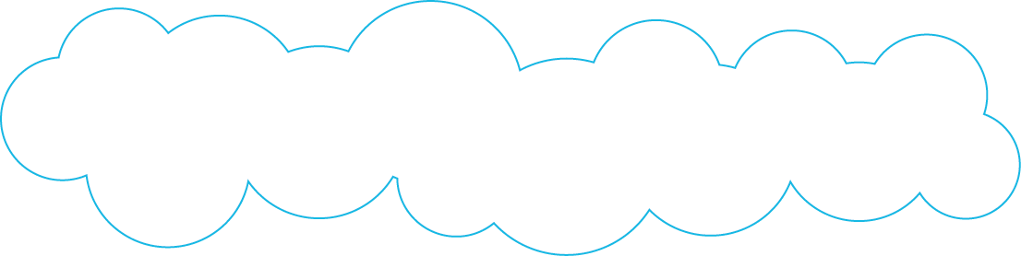
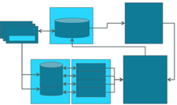
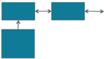
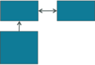
Notes:
Building an infrastructure from legacy technology for cloud applications leads to a chaotic, operationally complex and difficult patchwork of backend technologies, not to mention the latency introduced and required for ETL operations to create different models of data for different workloads OR for locality.

Slide 21
A Better Way
© DataStax, All Rights Reserved.
Notes:
DataStax Enterprise, with it’s multi-model, multi workload architecture is a purpose built database that solves the challenges and demands of today’s Cloud applications. With a single, integrated platform, DSE provides the features that are required for Performance.
At the foundation of DSE is Cassandra….
With enhancements to support multii-model which are then utilized through different lines of functionality, such as Search, Analytics, Unified Security, Multi-Instance...

Slide 22
Overview of the DSE Solution
Starts with Apache CassandraTM - always-on, distributed, high performance, best database for cloud applications.
© DataStax, All Rights Reserved.
Notes:
At the core is Cassandra, known for high performance among the HA and scalability.

Slide 23
Do the Math
100,000
Txns/sec
200,000
Txns/sec
400,000
Txns/sec
© DataStax, All Rights Reserved.
Notes:
That means DSE provides linear scale, which allows you to easily grow with your users or data by adding machines as well as the fine grained replication controls.

Slide 24
End Point Benchmark
DataStax Enterprise beat Couchbase, MongoDB and HBase by a wide margin in every test
Read-Mostly
(90% reads; 10% updates)
Balanced
(50% reads; 50% updates)
Available as a whitepaper on DataStax.com
© DataStax, All Rights Reserved.
Notes:
Cassandra has also shown to be one of the fastest DB engines for either workload.

Slide 25
Overview of the DSE Solution
Starts with Apache CassandraTM - always-on, distributed, high performance, best database for cloud applications.
Adds adaptive data management with multiple, flexible data models (key-value, tabular, JSON/Document, Graph) stored in one integrated database, with each inheriting all the benefits of Apache CassandraTM.
© DataStax, All Rights Reserved.
Notes:
Next is the multi-model, data management capabilities.

Slide 26

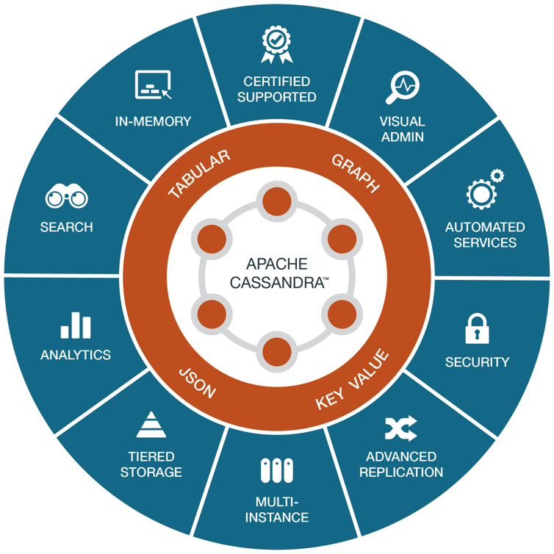
Multi-Model
Key/Value
Tabular
Graph
JSON
Notes:
With multi-model support we let you interact with data the way that makes sense for your application. Write data once, and it's visible to everyone.
In a single platform we've combined the ability to interact with Key/Value, tabular, Graph and JSON data.
Even more important is that we've also got multi-workload capabilities so that your analytics users and application developers can use the same platform, the same data to satisfy transactional, search, and analytics workloads. Write data once, and it's available to all these teams in real-time.
Instead of becoming database experts we let you focus on what matters most to your users.
DSE’s multi-model and mutil-workload solutions solve The Data Model Flexibility and Workload Isolation demands of

Slide 27


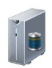
Why Multi-Model?
Transactional Analytical Search
Key-Value Tabular Document Graph
© DataStax, All Rights Reserved.
Notes:
As discussed previously, cloud applications consist of multi-workloads to provide different functionality associated with cloud interactions. In order to be performant at these different workloads, users will need to interact with data in different ways. This also potentially requires data being stored in different ways.
Enables instant cascading intelligence through multiple data models of tabular, JSON, and graph formats, that lets you to access data as needed by your application.
Handles multiple and varied data streams simultaneously in a single architecture, Live Indexing and Search capabilities bring real-time and high throughput capabilities to large scale, data-intensive applications in the same platform.
DataStax is Enterprise Ready with Automation making Operations intelligent – with capabilities like backup, performance, visual administration, repair services, tiered storage, advanced replication, etc. This also helps you get your cloud applications to production faster and easier.

Slide 28
Overview of the DSE Solution
Starts with Apache CassandraTM - always-on, distributed, high performance, best database for cloud applications.
Adds adaptive data management with multiple, flexible data models (key-value, tabular, JSON/Document, Graph) stored in one integrated database, with each inheriting all the benefits of Apache CassandraTM.
Finishes by providing commercial database extensions needed for production cloud applications
© DataStax, All Rights Reserved.
Notes:
At the core is Cassandra, known for high performance among the HA and scalability.

Slide 29
+
+
Distributed
Responsive
Intelligent
Masterless Architecture
Active Everywhere
Multi-Model
Private, Public & Hybrid
Low Latency
Mixed Workloads
Continuous Availability
Linear Scale
Operations Automation
Notes:
DataStax Enterprise is built from the ground up to power Cloud Applications
DSE is
Distributed:
Responsive:
Intelligent:
DataStax Enterprise is the platform that powers cloud applications to create real-time value at epic scale.

Slide 30
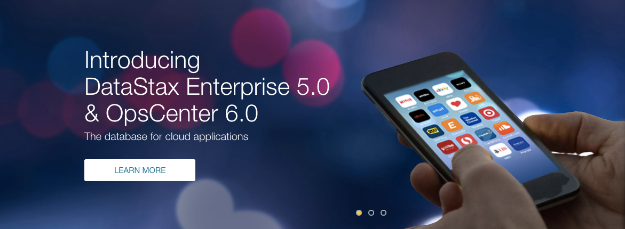
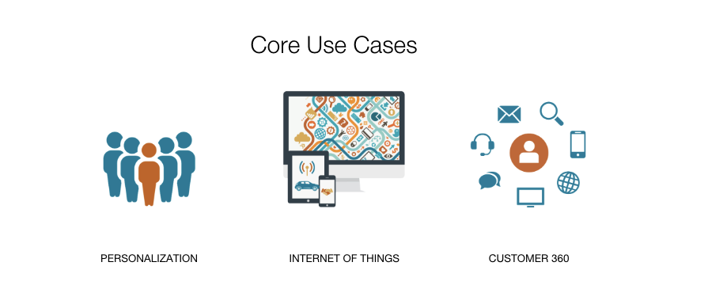
© DataStax, All Rights Reserved.
© DataStax, All Rights Reserved.

Slide 31
Overview of the Latest Release
DataStax Enterprise Server 5.0 – Multi-model with graph and more.
DataStax Studio 1.0 – Web-based developer solution for DSE Graph.
DataStax OpsCenter 6.0 – Enterprise provisioning and visual support for DSE Graph.
DataStax Drivers – Unifies development by having each driver for key languages support all data models in the platform.
© DataStax, All Rights Reserved.
Notes:
Added Graph support.
Studio for Graph

Slide 32
Two Key Objectives of DSE 5.0 Release
Deliver enterprise multi-model database platform that included support for graph.
Simplify the development and management experience of DSE.
© DataStax, All Rights Reserved.

Slide 33
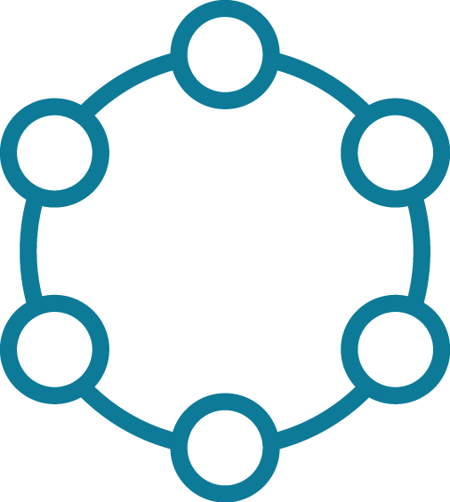
New in DSE 5.0 – Advanced Replication
Multi-cluster replication, hub-and-spoke. Supports sporadic connectivity.
Allows one-way replication from “edge” cluster to another, centralized hub cluster.
Ideal for retail, energy, “edge of the internet of things”, and data sovereignty use cases.
© DataStax, All Rights Reserved.
Notes:
Cluster to Cluster replication & 1 way replication.

Slide 34
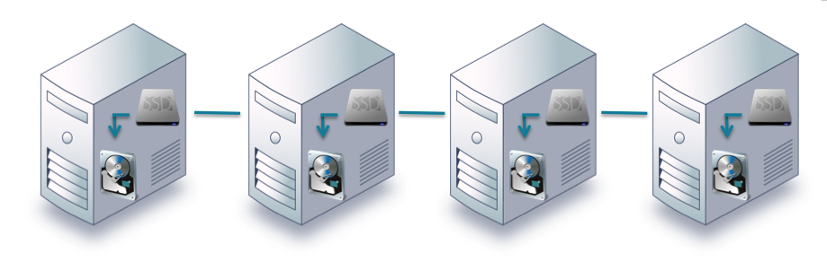
New in DSE 5.0 - DSE Tiered Storage
Able to automatically move data to different storage media based on defined criteria.
Helps reduce storage costs by relegating lesser-used or older data to less expensive storage devices.
Works on a granular per-row basis.
Smart diagnostics provide insight into I/O traffic.
© DataStax, All Rights Reserved.

Slide 35
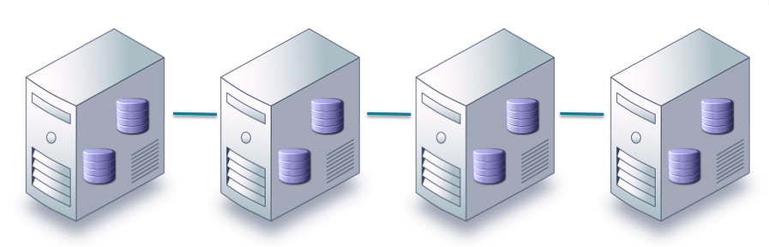
New in DSE 5.0 - DSE Multi-Instance
Allows for simple deployment of multiple DSE instances on a single machine.
Ensures large hardware resources are effectively utilized for database applications.
Helps reduce hardware cost.
© DataStax, All Rights Reserved.

Slide 36


Security Enhancements in DSE 5.0
Encryption for Apache CassandraTM and DSE Search commit logs and index files.
Role based access control.
Unified Authentication: Allows multiple security authentication protocols (e.g. Kerberos, LDAP, Active Directory, internal Apache CassandraTM) to be used on the same database cluster.
© DataStax, All Rights Reserved.

Slide 37

Integration with External Apache SparkTM Clusters
Connects transactional data stored in DSE with historical data contained in outside Apache SparkTM clusters.
Allows for moving and joining data together between the two platforms.
Support includes deployments from Cloudera and Hortonworks.
© DataStax, All Rights Reserved.

Slide 38
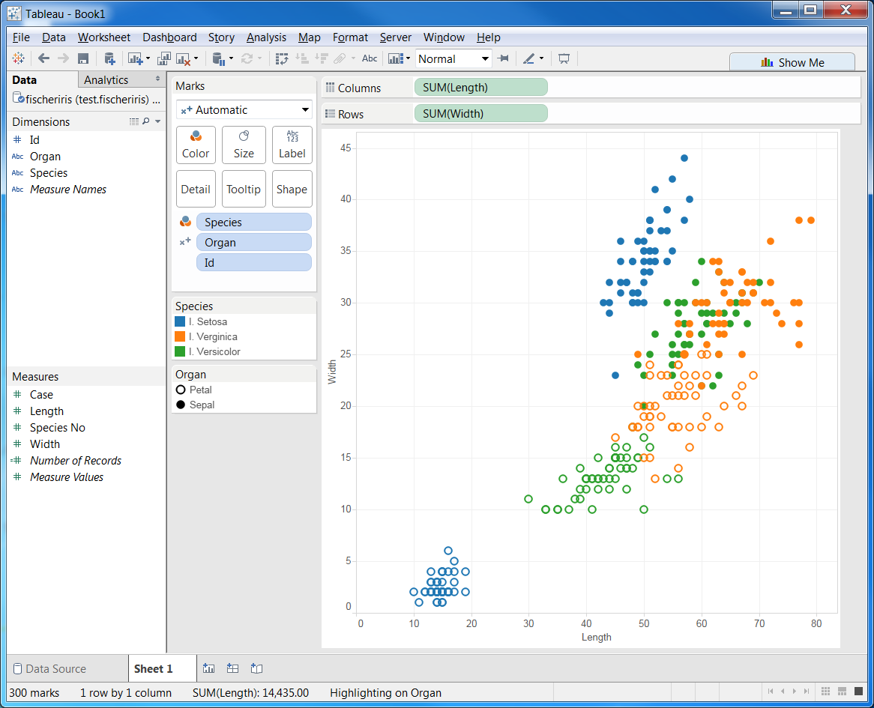
Tableau Ready
Perform operational analytics with Tableau.
Works with DSE 5.0 and Apache SparkTM upgrade.
© DataStax, All Rights Reserved.

Slide 39

DSE Search – Live Indexing Improvements
Utilizes memory outside “off-heap” JVM.
Improves efficiency and reduces latency between the inserting of new data and querying of that same data.
© DataStax, All Rights Reserved.

Slide 40
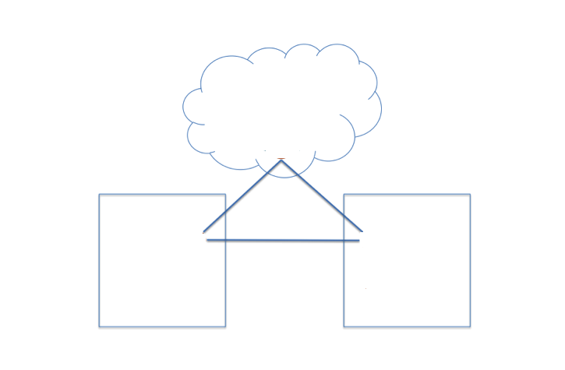
Certified Apache CassandraTM 3.0
Certifies Apache CassandraTM 3.0.x for production and enterprise-wide deployments.
Includes production certification for all Apache CassandraTM 3.0 features including materialized views and improved storage management, which delivers strong storage savings.
© DataStax, All Rights Reserved.

Slide 41
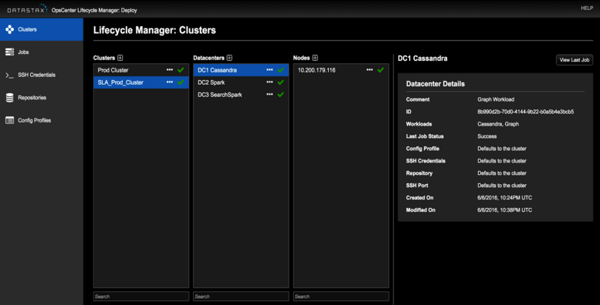
Manageability Enhancements in OpsCenter 6.0
Lifecycle Manager: Enterprise-class provisioning and change management for distributed database clusters.
© DataStax, All Rights Reserved.

Slide 42
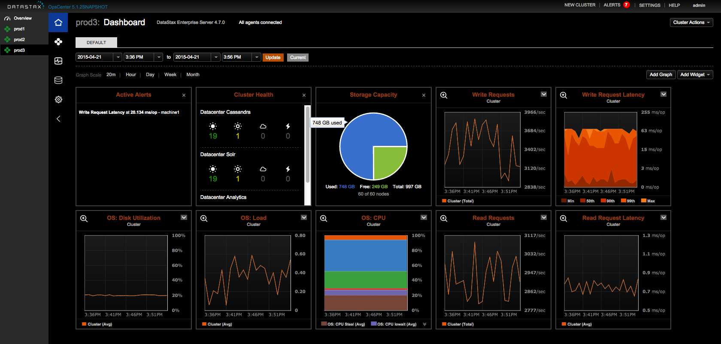
Manageability Enhancements in OpsCenter 6.0
DSE Graph support that includes:
Provisioning clusters
Graph database configuration
Monitoring graph metrics
More robust alerting capabilities, including SNMP support.
Integration with Graphite monitoring tool.
© DataStax, All Rights Reserved.

Slide 43
Subscriptions Overview
 | DSE Basic | DSE Standard | DSE Max
Database Management / Services
Enterprise/production certified Apache CassandraTM release | ✔ | ✔ | ✔
DSE Advanced Security |  | ✔ | ✔
DSE Automatic Management Services |  | ✔ | ✔
DSE Advanced Replication |  | ✔ | ✔
DSE Tiered Storage |  | ✔ | ✔
DSE Multi-Instance |  | ✔ | ✔
DSE In-Memory |  |  | ✔
DSE Search |  |  | ✔
DSE Analytics |  |  | ✔
DSE Graph |  | Option | Option
Management and Developer Solutions
DataStax OpsCenter |  | ✔ | ✔
DataStax Studio |  | ✔ | ✔
Support and Professional Services
Expert 24x7x365 Support with 1 hour SLA | ✔ | ✔ | ✔
Platform certification | ✔ | ✔ | ✔
Certified service packs | ✔ | ✔ | ✔
Hot fixes and bug escalation | ✔ | ✔ | ✔
Free software deployments for non-production environments | ✔ | ✔ | ✔
Health checks/Performance reviews | ✔ | ✔ | ✔
New
Enhanced
© DataStax, All Rights Reserved.

Slide 44
Challenge Accepted
Notes:
Let’s look at a few use cases that have accepted the Performance Challenge with DSE.

Slide 45
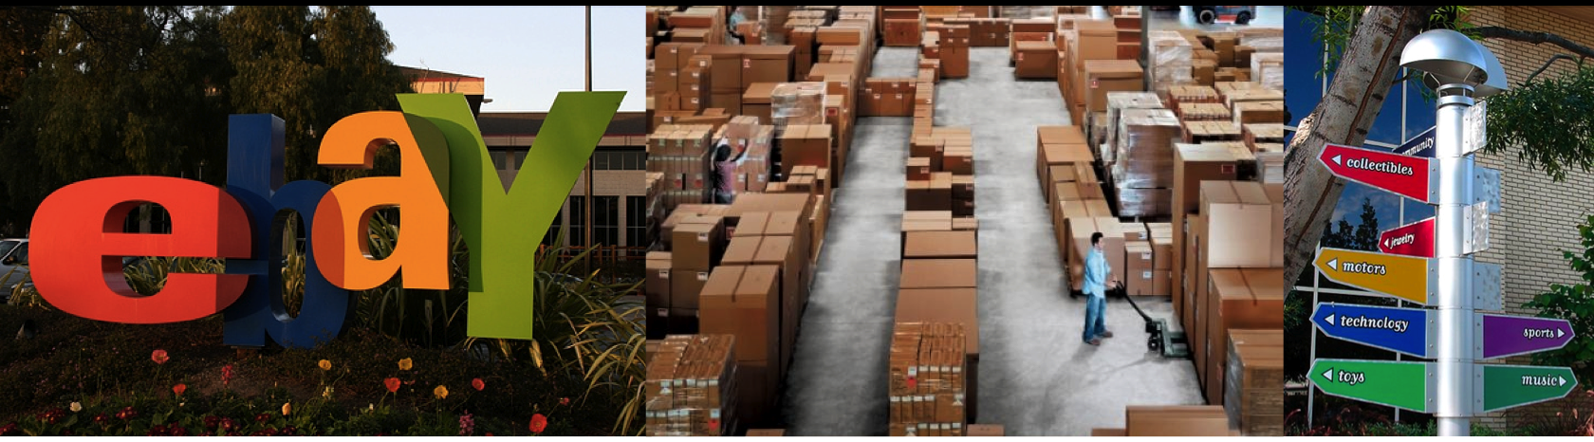
Six billion writes; 5 billion reads per day on DSE
100’s of TB’s of operational data on DSE
Multi-data center
One app utilizes a 40TB operational table
© DataStax, All Rights Reserved.

Slide 46
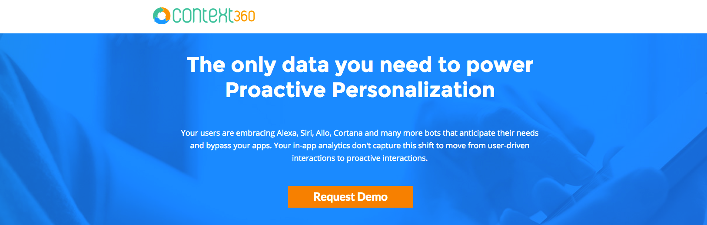
“We started with Postgres on Heroku. However, we hit issues early on because we would, for example, add a million new users with each new app, and no matter how much we’d tune Postgres, it simply couldn’t scale to the level we needed. To be honest, it was quite a nightmare.
With our solution, adding a new app can mean adding two million more users in the next hour, and we realized an RDBMS was simply not going to work for us. We had no way of being able to predict and ensure the performance we needed.” – Ratnam Tatavarty, CTO.
© DataStax, All Rights Reserved.

Slide 47
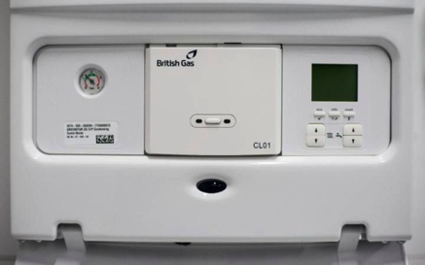
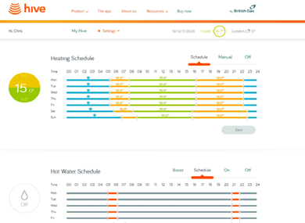
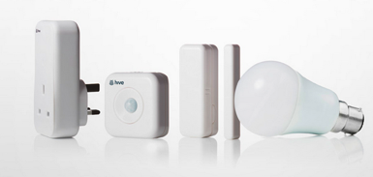
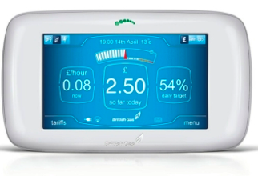


850,000 customers get the My Energy Report.
2 million+ smart meters deployed, 200k connected thermostats across 11 million customers.
Electricity reading every 10 seconds, gas reading every 30 minutes.
30 thousand messages per second.
Use Cases: Internet of Things, Messaging, Transactions, Authentication
Notes:
One company that has solved The Performance Challenge with DSE is British Gas.
Background:
Connected Boilers are sending real-time data for preventative maintenance to identify abnormal spikes and readings, and proactively schedule a repair
They have 2+million smart meters with in-home displays (you can see your consumption while you are standing in the kitchen, and via mobile apps) - that are sending electricity readings every 10 seconds and gas readings every 30 minutes. And British Gas is using machine learning to disaggregate the energy data to identify which devices are consuming how much energy – since meters have an total consumption – for e.g. refrigerators have very cyclical patterns where they go on and off
Their Hive Connected Thermostats are streaming temperature time series data
British Gas uses multi model to store different in different formats, whether the key value style IoT data or the more tabular Analytical information used to compute outcomes.
British Gas uses DSE’s multi workload solution to ingest different streams of data within a highly available set of nodes, while computing deep analytics on another set of highly available set notes all within the same DSE cluster, all without having to preform any ETL to synchronize data across systems.
British Gas, a 200 year old company has an innovated Connected Homes business unit and are competing with NEST and giving Google a run for its money.
They are a great example of a DSE customer who has solved TAC with DSE.

Slide 48
Conclusions

Slide 49

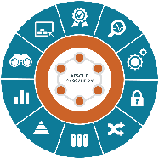
Notes:
DataStax Enterprise is built from the ground up to power Cloud Applications
DSE is
Distributed:
It has a completely masterless design where every node acts independently for reads and writes
Enables a comprehensive, multi-datacenter strategy and works seamlessly across on-premise, cloud, hybrid implementations.
DSE was built from the ground up to have no single point of failure. We have many customers that have been able to maintain 100% uptime over 3+ years.
Responsive:
“Active Everywhere” which means fully active reads/writes, distributed where you need it.
Low Latency with response times fast enough for your most intense operational cloud applications.
DSE provides linear scale, which allows you to easily grow with your users or data by adding machines and allows scaling without changes to the core architecture.
Intelligent:
Enables instant cascading intelligence through multiple data models of tabular, JSON, and graph formats, that lets you to access data as needed by your application.
Handles multiple and varied data streams simultaneously in a single architecture, Live Indexing and Search capabilities bring real-time and high throughput capabilities to large scale, data-intensive applications in the same platform.
DataStax is Enterprise Ready with Automation making Operations intelligent – with capabilities like backup, performance, visual administration, repair services, tiered storage, advanced replication, etc. This also helps you get your cloud applications to production faster and easier.
DataStax Enterprise is the platform that powers cloud applications to create real-time value at epic scale.

Slide 50
Before we go…a few reminders
Download DSE 5.0, available today!
Next Webinar (Oct 5th): Macy’s – Why Your Database Decision Directly Impacts Customer Experience. Register Today!
Check out upcoming webinars here: http://www.datastax.com/resources/webinars
Become a DataStax Professional Community Member: http://academy.datastax.com/community
© DataStax, All Rights Reserved.
Notes:
Allene will do this slide.

Slide 51
Q & A
© DataStax, All Rights Reserved.
51

Slide 52
Thank You!

